Slide 1
Lecture 3
Number System
MOHD. YAMANI IDRIS/ NOORZAILY MOHAMED NOOR
1

Slide 2
Topics
Information Representation
Position sign
Decimal number system (base 10)
Number system and conversion of base R number to decimal
Decimal to binary conversion
Base conversion
Binary – octal/hexadecimal conversion
Base 2 arithmetic operation
Negative number
Comparison between sign & magnitude and complement
Complement
MOHD. YAMANI IDRIS/ NOORZAILY MOHAMED NOOR

Slide 3
Information Representation
Number is important in computer:
  Represent information accurately
  Can be processed
For Example:
  To represent yes or no, use 0 for yes and 1 for no
  To represent four seasons, fall(0), winter(1), spring(2), summer(3)
  IC number
  Matrics number
MOHD. YAMANI IDRIS/ NOORZAILY MOHAMED NOOR

Slide 4
Position Number
Sign free from position
  Every symbol free free from position – Egypt number system
Number relative to position
  Roman number system I(1), V(5), X(10), C(50), M(100)
  Relative is important – IV(4), VI(6)
Calculation is hard for both number system
MOHD. YAMANI IDRIS/ NOORZAILY MOHAMED NOOR

Slide 5
Position Number
Weighted positional notation
  Decimal number system
  Position is important
  E.g.
  Value depends on its position
Generally
MOHD. YAMANI IDRIS/ NOORZAILY MOHAMED NOOR

Slide 6
Position Number
Fraction
Generally
Other bases
MOHD. YAMANI IDRIS/ NOORZAILY MOHAMED NOOR

Slide 7
Decimal Number System (Base 10)
Weight power of 10
Example 593.68
MOHD. YAMANI IDRIS/ NOORZAILY MOHAMED NOOR

Slide 8
Number system and conversion of base R number to decimal
Binary (base 2) numbers weighted power of 2
  Binary digit (bit): 0, 1
Octal (base 8) numbers weighted power of 8
  Octal digital: 0,1,2,3,4,5,6,7
Hexadecimal (base 16) numbers weighted power of 16
  Hexadecimal digit: 0,1,2,3,4,5,6,7,8,9,A,B,C,D,E,F
Therefore, base R number weighted power of R
MOHD. YAMANI IDRIS/ NOORZAILY MOHAMED NOOR

Slide 9
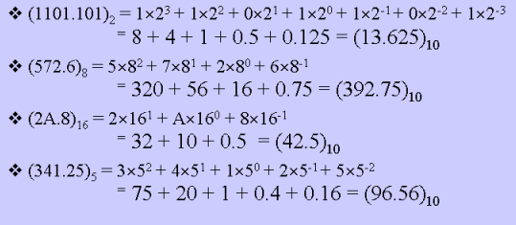
Number system and conversion of base R number to decimal
should be 5/25=0.2
95.6
MOHD. YAMANI IDRIS/ NOORZAILY MOHAMED NOOR

Slide 10
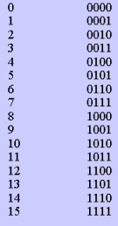
Number system and conversion of base R number to decimal
Count in binary
If there’s n-bit => largest value 2^{n}-1
Range for m =>log₂m bit
Decimal Binary
MOHD. YAMANI IDRIS/ NOORZAILY MOHAMED NOOR

Slide 11
Decimal to Binary Conversion
Weight summation method
Repeating Division with 2 (for integer)
Repeating Multiplication with 2 (for fraction)
MOHD. YAMANI IDRIS/ NOORZAILY MOHAMED NOOR

Slide 12
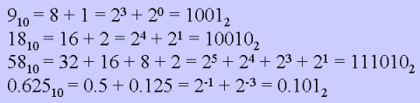
Weight summation method
Convert all number set to binary number
MOHD. YAMANI IDRIS/ NOORZAILY MOHAMED NOOR

Slide 13
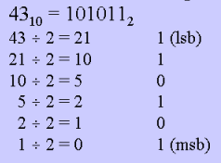
Repeating Division with 2
Example:
Remainder
Remainder
Remainder
Remainder
Remainder
Remainder
MOHD. YAMANI IDRIS/ NOORZAILY MOHAMED NOOR

Slide 14
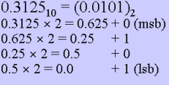
Repeating Multiplication with 2
Multiply until 0 (or given decimal notation)
Example:
msb = most significant bit
lsb = least significant bit
MOHD. YAMANI IDRIS/ NOORZAILY MOHAMED NOOR

Slide 15
Conversion Between Bases
Base R to decimal: digit multiplication with appropriate weight
Decimal to binary (base 2)
  Integer: repeating division with 2
  Fraction: repeating multiplication with 2
Decimal to R
  Integer: repeating division with R
  Fraction: repeating multiplication with R
MOHD. YAMANI IDRIS/ NOORZAILY MOHAMED NOOR

Slide 16
Conversion Between Bases
Generally, conversion between bases can be done using decimal numbers
Base 2 Base 2
Base 3 Base 3
Base 4 Decimal Base 4
…… ……
Base R Base R
There are shortcuts for 2,4,8,16
MOHD. YAMANI IDRIS/ NOORZAILY MOHAMED NOOR

Slide 17
Conversion Binary-Octal/Hexadecimal
Binary=>Octal:Grouped 3-bit from radix point
Octal=>Binary: Invert
Binary=>Hexadecimal:Grouped 4-bit from radix point
Hexadecimal=>Binary:
MOHD. YAMANI IDRIS/ NOORZAILY MOHAMED NOOR

Slide 18
Binary Arithmetic Operation
Addition
Subtraction
Multiplication
MOHD. YAMANI IDRIS/ NOORZAILY MOHAMED NOOR

Slide 19
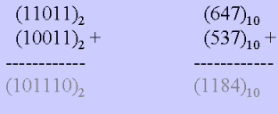
Binary Arithmetic Operation
ADDITION
Similar to decimal
Example:
MOHD. YAMANI IDRIS/ NOORZAILY MOHAMED NOOR

Slide 20
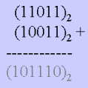
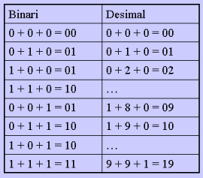
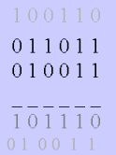
Binary Arithmetic Operation
Addition Digital Table:
MOHD. YAMANI IDRIS/ NOORZAILY MOHAMED NOOR

Slide 21
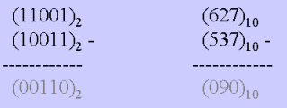
Binary Arithmetic Operation
SUBTRACTION
Example
MOHD. YAMANI IDRIS/ NOORZAILY MOHAMED NOOR

Slide 22
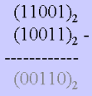
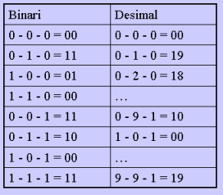
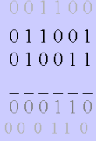
Binary Arithmetic Operation
Subtraction Digital Table:
MOHD. YAMANI IDRIS/ NOORZAILY MOHAMED NOOR

Slide 23
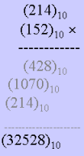
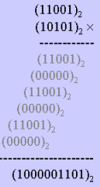
Binary Arithmetic Operation
MULTIPLICATION
Example:
MOHD. YAMANI IDRIS/ NOORZAILY MOHAMED NOOR

Slide 24
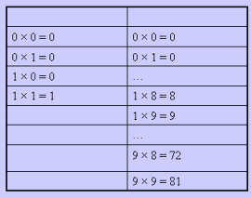
Binary Arithmetic Operation
Multiplication Digital Table:
Binary Decimal
MOHD. YAMANI IDRIS/ NOORZAILY MOHAMED NOOR

